Slide 1
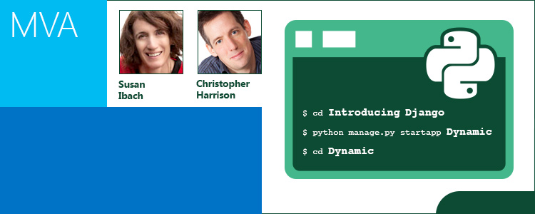
Building Websites with Python and Django

Slide 2


Join the MVA Community!
Microsoft Virtual Academy—Free online training!
Tailored for IT Pros and Developers
Over 1M registered users
Earn while you learn!
50 MVA Points for this event!
Visit http://aka.ms/MVA-Voucher
Code: PythonDjango (expires July 20, 2015)

Slide 3

Agenda
9:00-10:00 | 01 | Introducing Django
10:00-11:00 | 02 | Building models and databases
11:00-12:00 | 03 | Querying data
12:00-1:00 | | Meal break
1:00-2:00 | 04 | URLs and routing
2:00-3:00 | 05 | Views and forms
3:00-4:00 | 06 | Deployment and next steps

Slide 4
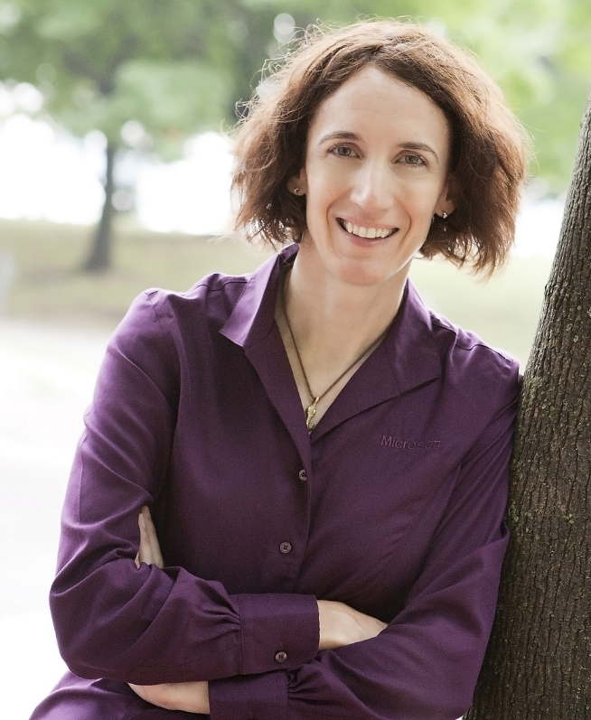
Get to know today’s presenters
Susan Ibach
Senior Technical Evangelist
@hockeygeekgirl
Susan Ibach is a self-professed geek and hockey nut. She is currently working as a Technical Evangelist for Microsoft Canada. This means she gets to share her geeky jokes with tech enthusiasts across the country! She taught computer programming and databases for more than 10 years and was known for her high-energy presentations. In her current role, she continues to introduce new technologies to fellow developers to help them on their projects and in their careers.
Sanjay Soni
Microsoft Senior Product manager
@SQLBI101
Sanjay Soni is a Senior Technical Product Marketing Manager on the SQL Server Business Intelligence (BI) and Data Warehousing Marketing team at Microsoft. His previous Microsoft roles include Business Intelligence Evangelist, responsible for enabling self-service BI to more than 40,000 users at Microsoft. Sanjay is known for his passion and enthusiasm and for driving structure and delivering results for BI and data warehouse customers for 15 years.

Slide 5

Get to know today’s presenters
Christopher Harrison
Senior Content Developer
@geektrainer
Christopher Harrison is a self-proclaimed geek with a passion for development and educating others. He got his first introduction to technology when his father brought home a VIC-20, graduated to a Commodore 64, and kept growing from there. Christopher parlayed that into a long career as a Microsoft Certified Trainer (MCT), with a focus on .NET development, SharePoint, and SQL Server. When offered the opportunity to become a Content Developer at Microsoft, he just couldn't resist and he made the jump.
Sanjay Soni
Microsoft Senior Product manager
@SQLBI101
Sanjay Soni is a Senior Technical Product Marketing Manager on the SQL Server Business Intelligence (BI) and Data Warehousing Marketing team at Microsoft. His previous Microsoft roles include Business Intelligence Evangelist, responsible for enabling self-service BI to more than 40,000 users at Microsoft. Sanjay is known for his passion and enthusiasm and for driving structure and delivering results for BI and data warehouse customers for 15 years.

Slide 6

Are you an entrepreneur?
Your startup may be eligible for three years of free software, support, visibility and up to $60,000 in free, open-source friendly Microsoft Azure
Visit http://aka.ms/mvajoinbizspark for details

Slide 7
New to Visual Studio?
See how easy it is to get started with Visual Studio, connect to Visual Studio Online, and begin collaborating with your team.
Try it for free!
Visit http://aka.ms/MVATryVisualStudio for details

